Slide 1
Job Application Tracker

Slide 2
Project overview
Job seekers often apply to multiple positions across different platforms such as LinkedIn, company websites, and job portals. Tracking application statuses manually through emails or memory can lead to missed follow-ups, duplicated applications, and poor organization. There is a need for a centralized system that allows users to record job applications, monitor progress, schedule follow-ups, and analyze their job search activity efficiently.

Slide 3




Meet
the team
Shu Wang
Violetta Krotova
Kacie Dearman
Paige Li

Slide 4
Deliverables
Deliverable
Due date
Team responsible
Implemented the authentication flow, including login and account creation pages, with form handling, basic validation, and routing to support user access to the app, and set up the folder
10/13-10/14
Shu
Built the core of the form and I developed placeholders with demo data and handlers functions to test the table functionality and workflow so later on my teammates can implement the table as a reusable component and connect to the backend.
Violetta
10/13-10/14
Connected backend and frontend.
10/13-10/14
Kacie
Built a reusable table component to display submitted jobs and integrated Violetta’s form into the same screen. I then created a Dashboard view to encapsulate this functionality, keeping changes isolated from App.jsx. The Dashboard serves as the routed view, while the table remains a reusable component.
10/13-10/14
Paige

Slide 5
Live
Demo

Slide 6
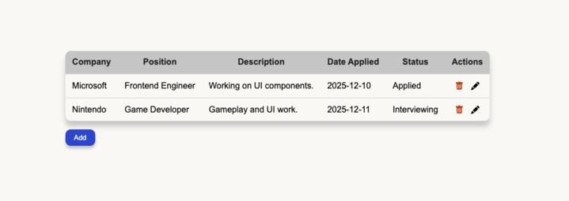
Proposed Solution: Job Application Tracker System
Company Name
01
02
03
A Job Application Tracker is a digital tool that helps users organize and manage their job applications in one place.
Job Application Management
Store Company, Job Title, Description, Date Applied and Status
.
Status Tracking
Application statuses such as:
*Applied *Interview
*Scheduled
*Rejected

Slide 7
Important lessons Learned
Key learning 1
Collaboration improves when roles are clear (but flexible)
Key learning 2
Clear communication is important. Misunderstandings cause more delays than lack of skill.
Key learning 3
It was a good learning experience to work with teammates who have different styles and methods.

Slide 8
Future Enhancement
01
Parse Resume
02
Automatically parse Job title/automate
03
Store Company URL

Slide 9

Q&A
Any questions? Ask away!

